Slide 1
LOSSLESS Decompostion

Slide 2
Decomposition of a relation is done when a relation in relational model is not in appropriate normal form. Relation R is decomposed into two or more relations if decomposition is lossless join as well as dependency preserving.
Lossless Join Decomposition
If we decompose a relation R into relations R1 and R2,
Decomposition is lossy if R1 ⋈ R2 ⊃ R
Decomposition is lossless if R1 ⋈ R2 = R

Slide 3
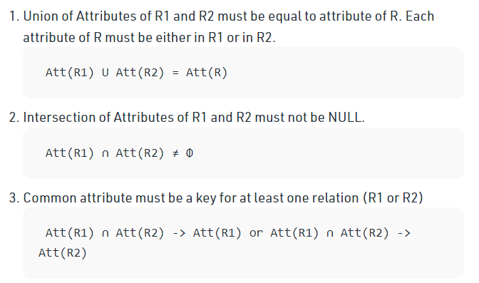
To check for lossless join decomposition using FD set, following conditions must hold:

Slide 4
For Example, A relation R (A, B, C, D) with FD set{A->BC} is decomposed into R1(ABC) and R2(AD) which is a lossless join decomposition as:
First condition holds true as Att(R1) U Att(R2) = (ABC) U (AD) = (ABCD) = Att(R).
Second condition holds true as Att(R1) ∩ Att(R2) = (ABC) ∩ (AD) ≠ Φ
Third condition holds true as Att(R1) ∩ Att(R2) = A is a key of R1(ABC) because A->BC is given.

Slide 5
Dependency Preserving Decomposition
If we decompose a relation R into relations R1 and R2, All dependencies of R either must be a part of R1 or R2 or must be derivable from combination of FD’s of R1 and R2. For Example, A relation R (A, B, C, D) with FD set{A->BC} is decomposed into R1(ABC) and R2(AD) which is dependency preserving because FD A->BC is a part of R1(ABC).

Slide 6
Consider a schema R(A,B,C,D) and functional dependencies A->B and C->D. Then the decomposition of R into R1(AB) and R2(CD) is
A. dependency preserving and lossless join B. lossless join but not dependency preserving C. dependency preserving but not lossless join D. not dependency preserving and not lossless join

Slide 7
Answer: For lossless join decomposition, these three conditions must hold true:
Att(R1) U Att(R2) = ABCD = Att(R)
Att(R1) ∩ Att(R2) = Φ, which violates the condition of lossless join decomposition. Hence the decomposition is not lossless.
For dependency preserving decomposition, A->B can be ensured in R1(AB) and C->D can be ensured in R2(CD). Hence it is dependency preserving decomposition. So, the correct option is C.

Slide 8
Dependency Equivalence
Canonical Cover
In the case of updating the database, the responsibility of the system is to check whether the existing functional dependencies are getting violated during the process of updating. In case of a violation of functional dependencies in the new database state, the rollback of the system must take place.
A canonical cover or irreducible a set of functional dependencies FD is a simplified set of FD that has a similar closure as the original set FD.

